Slide 1
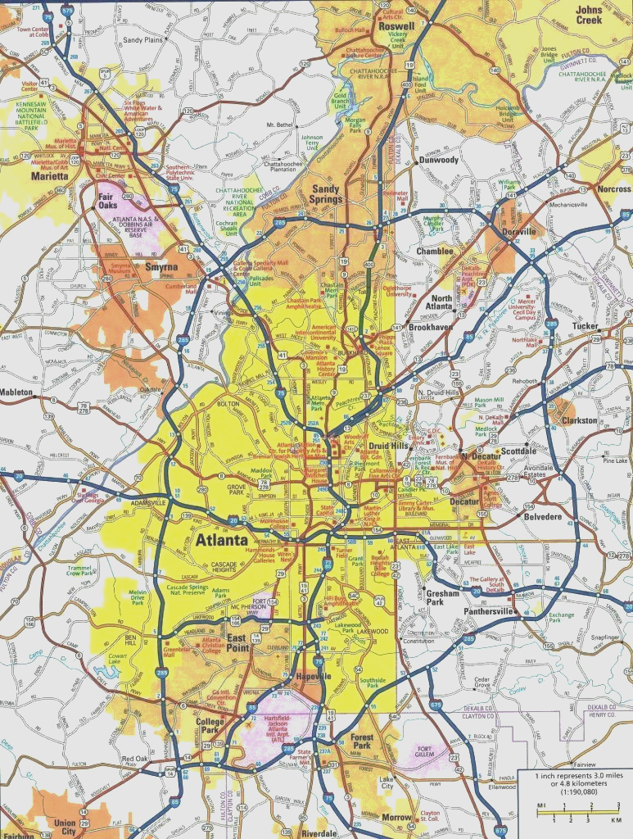
Crime in Atlanta, GA, 2009-Sept. 2021
Team members: Antoine Perrymon, Wesley Watkins, Cornelia Miller, Chineze Okpala, Anthony Ndungu, AJ Lamar III, Evan Mickler, Beverly Phillips
Notes:
We are presenting our project on the crime rate of Atlanta GA from 2009 to september 2021.

Slide 2

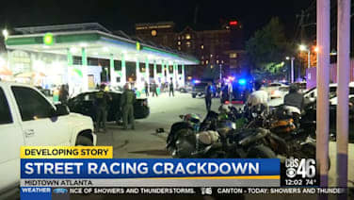
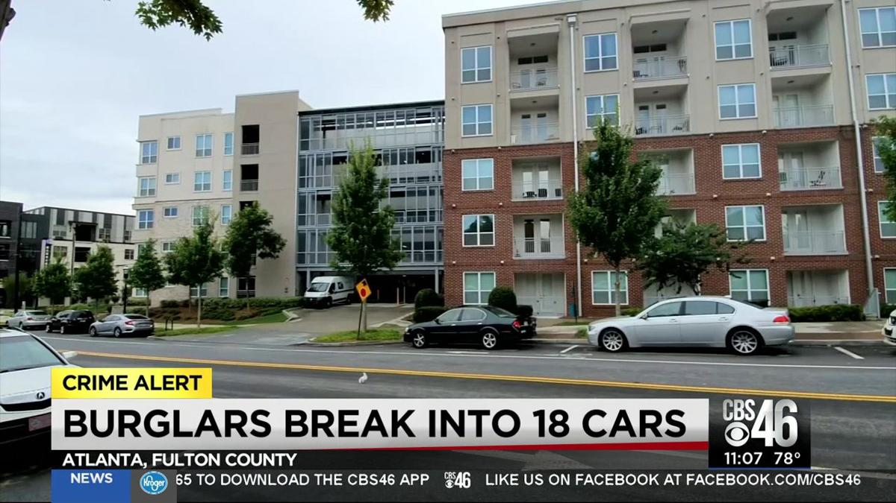
Motivation & Summary
The news media has given the impression that crime has increased over the last year during the pandemic, but how has crime trended over time?
Notes:
It is a common belief that crime has increased in atlanta over the past few years. But has it?
Has the amount of crime, severity of crime, or type of crime really changed?
Has the data been misconstrued to fit a narrative or has crime been an increasing problem for the city.

Slide 3

Questions to Answer
How has crime been trending over the past decade?
More active months? Seasons? Weather?
Where are the hotspots of crime in the city?
Particular neighborhoods? Racial boundaries?
Has unemployment contributed to crime?
How has the pandemic affected the rate of crime in the city?
Notes:
To answer this question we need to understand crime in Atlanta.
The first question to ask is: how has the overall amount of crime been trending over time?
How is that crime distributed over the city?
Due to the major political, financial, and health upheavals over the past decade that have wreaked havoc on the economy, how has unemployment affected crime?
And how has the latest global catastrophic health event affected crime?

Slide 4
Data Acquisition
Atlanta Police Department Data (2009 - SEP-2021)
Racial and geographic data gathered from 2020 Census via IPUMS-NHGIS
Google maps API
Openweatherapi
Covid data from the Georgia department of public health and the CDC
Georgia Department of Labor, Georgia Labor Market Explorer (2009-Sept 2021)
Notes:
We gathered our data from several locations, but the most relevant piece of data was from the APD. Whose dataset ultimately led to the limiting factor of our research.
Information about covid-19 cases was drawn from the Georgia department of health and the CDC.
Weather data was gathered using the openweather API.
Geographic data was drawn from the google maps API and from the Census.
Racial demographics was also pulled from the Census.
Unemployment data was taken from the georgia department of labor.

Slide 5
Data Cleanup and Exploration
Normalized crime data files
Removing unnecessary columns,
Renaming columns with different headers with the same values
Reordering if necessary
Removed all non-date values.
Removed all dates outside of scope of analysis (January 2009 - September 2021)
Created year/month/day columns.
Merged Crime data with other data sets on one or both of these columns.
Notes:
While exploring the crime data I realized that, although it all came from the same source, the formats were heterogeneous in column name and number of columns.
To resolve this I determined which columns felt necessary for our analysis, removed unnecessary columns, and reordered all columns to match the most recent version of the file.
I also noted that although the files were dated by year, there was data included from dates outside of our target time from of 2009- Sep 2021, and the date formats needed to be normalized.
I normalized all dates to the dd/mm/yyyy format, and used this string to calculate individual columns for year, month, and day. This would also allow for more in depth analysis later.
Once this was completed I dropped any year values that did not begin with ‘20’ deleting both data older than 2000 and any non numerical values in the date column. I, further, dropped any rows from before 2009 and after september 2021.
I created multiple versions of the crime data, aggregating on year and month year, and merged this data to out other data sets using one or both of these columns.
Once aggregated by year, it was interesting to note the obvious downward trend in crime in Atlanta.

Slide 6
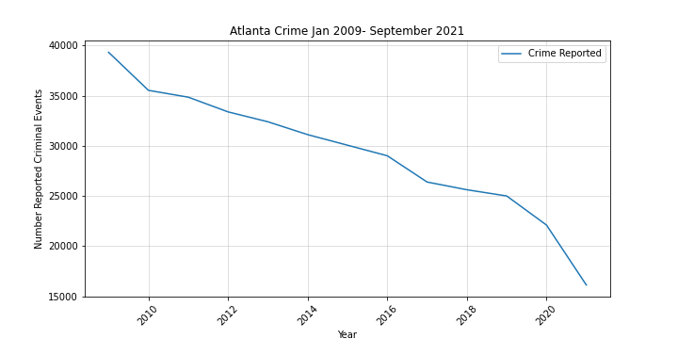
When is the most crime?
Crime over the last 12 years

Slide 7
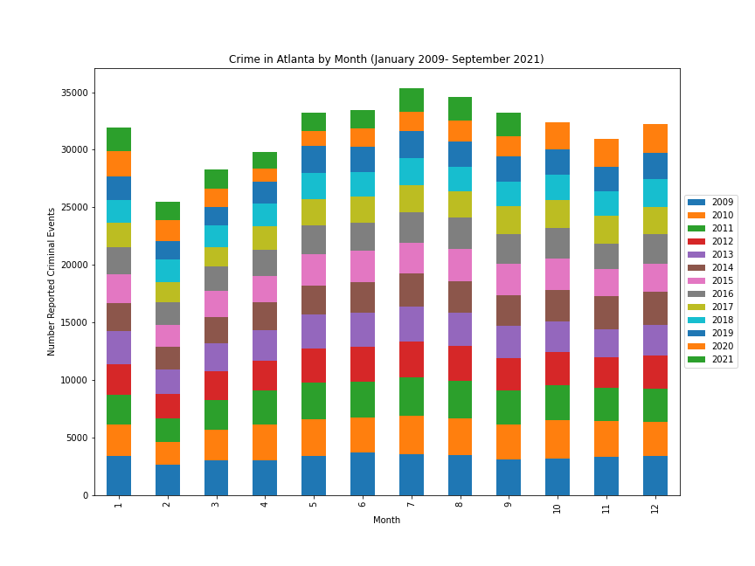
When is the most crime?
Crime in Atlanta by Month
Months with the most Crime
July
October-December
Months with the least amount of crime
February - April
Notes:
We were also wondering if there were any months where Atlanta was more likely to see an increase in crime?
For each year we gathered the amount of crime occurrences per month.
We created a stacked bar graph to visualize this data.
Months where we saw an increase in crime were July (summer) and October-December we do not have the 2021 data but we found there was a uptick in crime during the holiday season each year.
There was a notable decrease in crime during February - that is the shortest month of the year, but the trend continues through March and April having decreased crime.

Slide 8
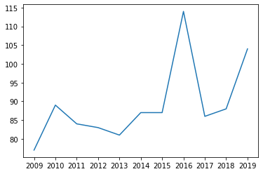
Types of Crimes committed
Homicide rate for 2009–2019
Notes:
It looks like the 2015 data might be off, we can either ignore it, change it, or explain it during the presentation. A sample sized data was used, which could explain why 2015 looks flat
In 2015, there was a spike in gang activity which accounted for 17% of the homicide rate.

Slide 9
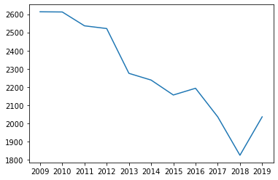
Types of Crimes committed
Aggravated Assault rate for 2009–2019
Notes:
Spike is in 2009 could be do to the recession and continues to decrease, until 2015 and 2016. Just like the homicide graph, the aggravated assault rate increased in 2015 and 2016. After 2016 there was a decrease until 2019. Just like the homicide rate, there was a bit of an increase in the aggravated assault rate

Slide 10
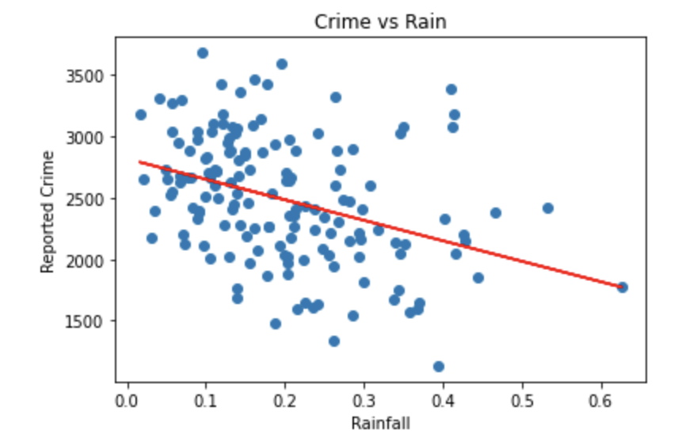
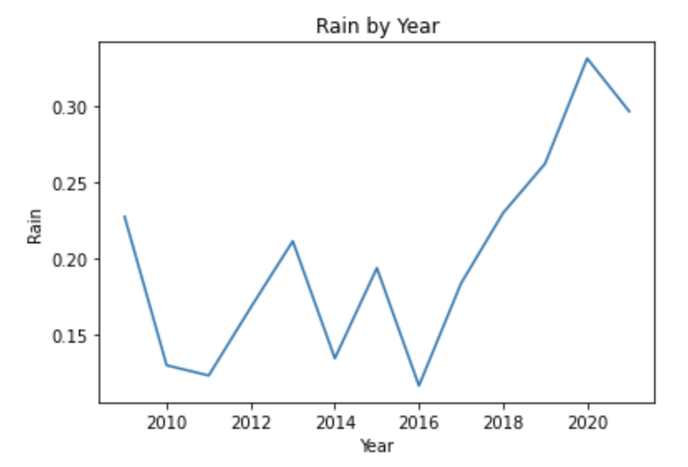
Does Weather Affect Crime?
Notes:
While, it was a longshot, we thought we would check crime against weather patterns. While most weather patterns showed little to no correlation with crime, we found it interesting that there appeared to be a weak to moderate negative correlation with an r-value of -0.37.
We also noted an increase in rainfall from 2016 to 2021 which is in-line with the decrease in crime over the same time period. Suffice to say, we thought there might be more to the story than criminals not wanting to get wet, and decided to keep digging.

Slide 11
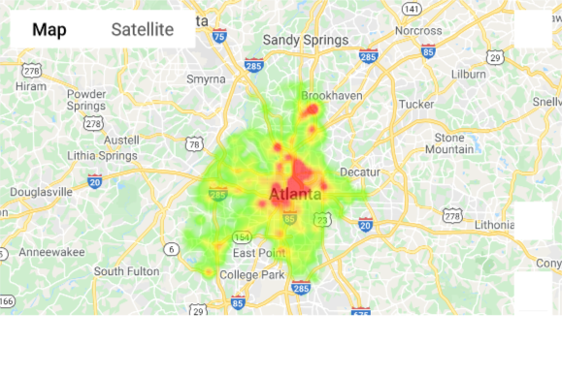
Where Is the most crime?
Heatmap of crimes reported from 2009-2019

Slide 12
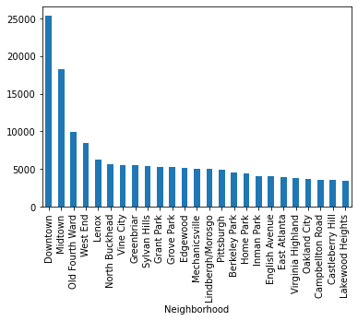
Where is the most crime?
Bar chart of crimes reported 2009-2019 by neighborhood

Slide 13
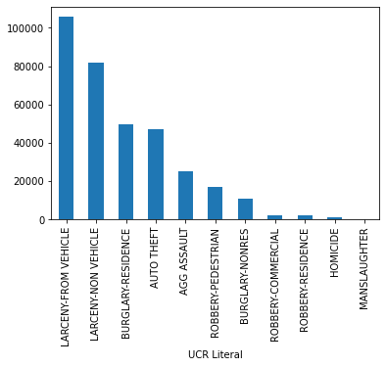
What type of crime is most common?
Bar chart of crimes reported in 2009-2019 by type of offense

Slide 14
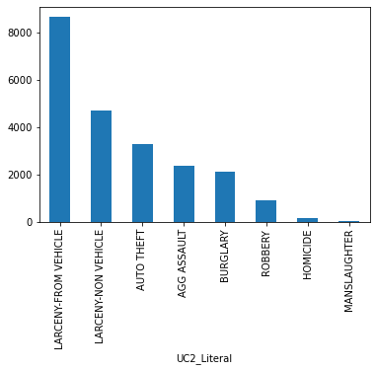
What type of crime is most common?
Bar chart of crimes reported in 2020 by type of offense

Slide 15
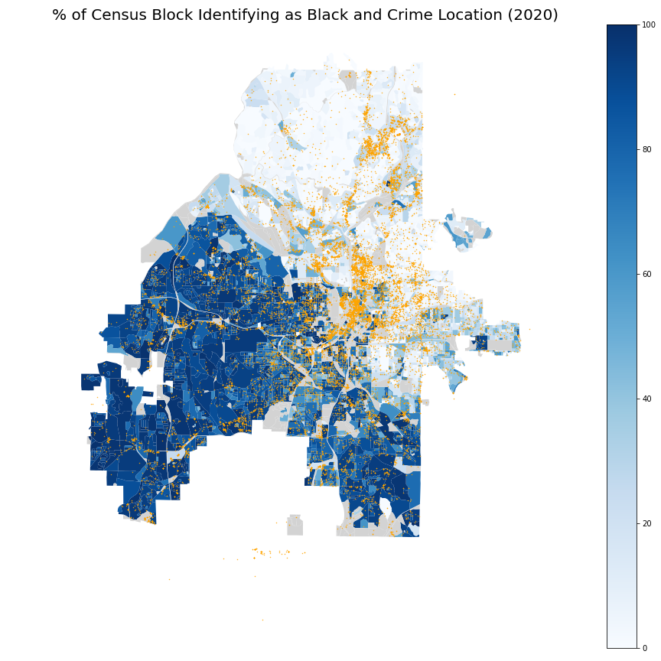
Crime Along
Racial Boundaries
Notes:
There is a prevalent myth that cultural boundaries create tension in a population and it is implied that crime increases near these boundaries.
From the graph, just from visual inspection, it doesn't appear like there's an increase in crime along racial boundaries.
It looks more like crime follows major roadways, and is concentrated in areas of high property value..
A possible explanation for why crime follows roads is that the main type of crime in Atlanta is larceny from a vehicle.
Being close to a fast roadway in high value areas would allow criminals access to high value targets and rapid transportation away from the scene of the crime.
Though, further research is still needed.

Slide 16
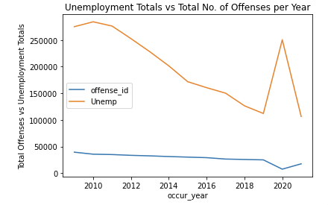
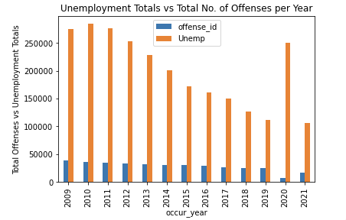
How does unemployment affect the crime rate?
Notes:
The data showed that there was a spike in unemployment during 2020, due to the COVID pandemic. However, there was a decrease in crime during that same year. Ironically it was the lowest over the 12 year time period. This shows that although more people in Atlanta were unemployed that did not have any effect on the amount of crime being committed.

Slide 17
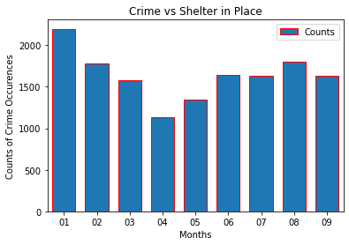
Crime during period of Shelter in Place due to Covid-19,
Jan to Sept., 2020
Shelter in place began, March 14th
Shelter in place ends, April 13th
Shelter in place ends, April 13th
Antoine
Notes:
As we all know, the increase of Covid in 2020, impacted just about every major city in the U.S to include Atlanta. This led government leaders to mandate executive orders for business closures and shelter in place.
This bar plot shows the rate of crime during that period in Atlanta. As you can see crime started to drop around the time the shelter in place order was mandated in March, represented by the yellow line. On April 13th, the governor lifted the order and you can see the result of crime occurrences slowly started to increase.
This could be due to less people on the streets and less partying and drinking. If you didn’t know, Atlanta is known for its nightlife.

Slide 18
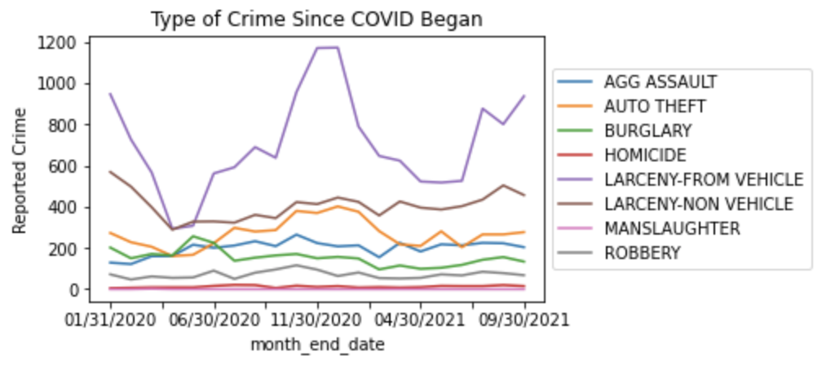
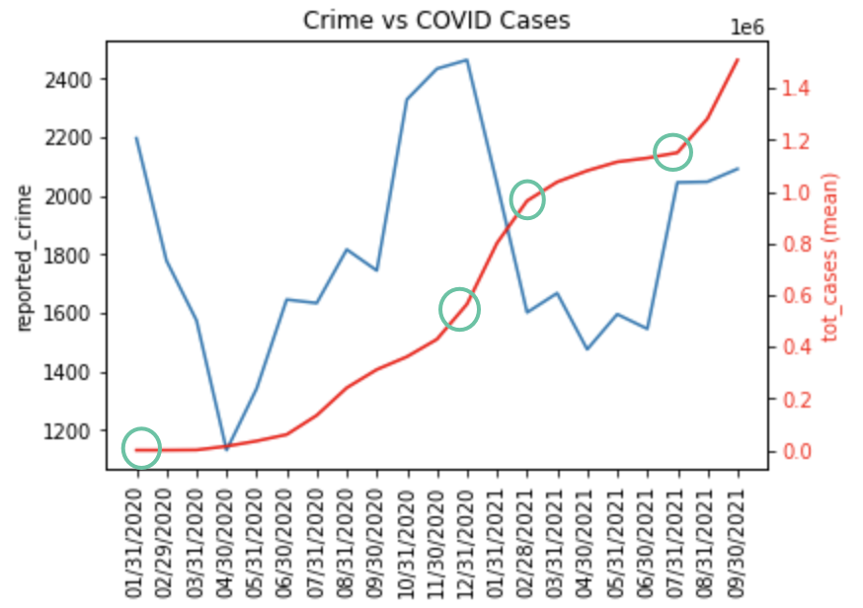
COVID and Crime: Closer Look
Notes:
While for the most part crime and COVID cases appear to be positively correlated, we noticed that whenever there appeared to be an inflection point in the curve for covid cases there was also an immediate opposite reaction in the crime curve leading us to believe these shocks either deterred criminals or reduced opportunities for them to engage in criminal activity(such as large events garnering attention from neighboring states). This would also be in line with our analysis showing mot crimes happening downtown and midtown, where most of these events would occur.

Slide 19
Discussion
Where is crime occuring?
Primarily in areas of high property value. Why?
Unemployment is a good indicator of crime- except in 2020!
Crime did not increase in 2020 as unemployment increased. Why?
Most crime has decreased during the COVID-19 pandemic.
Uptick in Larceny from Vehicle
Crime has decreased over the last 12 years- since the Great Recession (2007-2009)
Uptick in violent crime is observed
Notes:
(This is where we tie it all together)
To summarize
Our observations show that crime is occurring along major interstates and in areas of high wealth. Most likely due to geo-financial incentive.
It appears that unemployment is a strong indicator of overall crime in the city. Though in 2020 crime decreased. This is probably due to a massive increase in government spending to keep residents home and content. Then as people became normalized to the pandemic and assistance wore off, crime went back to normal. The difference between the low and the high gave an impression that crime had increase for the year.
From our data it shows an overall downward trend of crime over the last decade. There was a dramatic decrease in burglary over the time period, there were national outbreaks of violent crime in 2016 and 2019, but other types of crime remained steady on the tract of decline.

Slide 20
Future Questions
Crime rate tracked over a year for each year.
To see if the dip in crime in the spring is normal.
Map of personal income and crime location.
Modify the boundary graph to have location data tied to type of crime.
Rain and Crime?
We found it very interesting that rain and crime had any correlation at all. While We do not in anyway believe rain causes crime, we do wonder if there is a larger connection between changes in the climate(global warming) and crime.
Crime and COVID
We also found it interesting that Larceny - From Vehicle had the greatest increase in reported offenses during the pandemic. This leads us to wonder if this crime might have been particularly affected by COVID Cases.
Does the Stay at home order deter criminals if they are aware that all residents of a neighborhood are actually home?
Are these crimes taking place in areas that are no longer being populated by cars? I.e. night clubs/bars?
Are these crimes all taking place during large events
Is this increase and decline completely cyclical, and COVID had no effect?

Slide 21
Questions?

